Slide 1
The Israeli Aggression on Gaza
July 8th - August 25th 2014

Slide 2
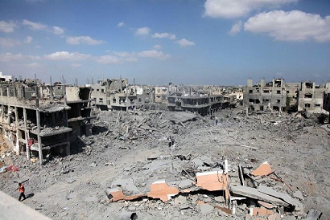
Beit Hanoun Destruction

Slide 3
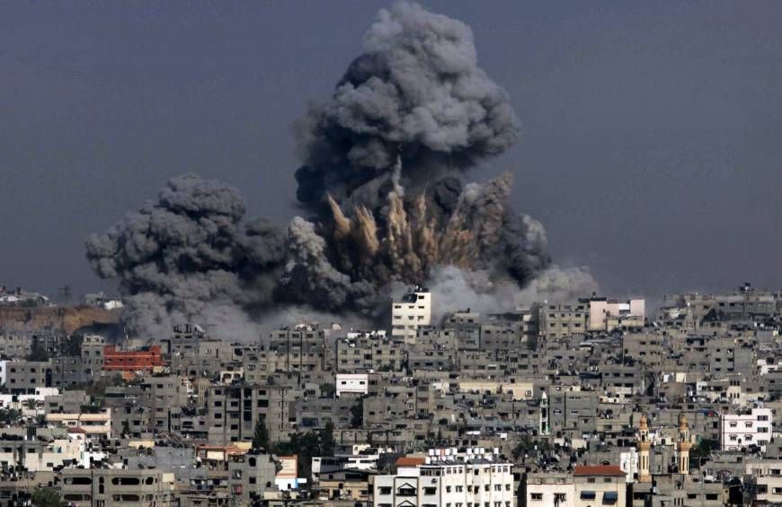
Bloodiest day yet in Gaza war leaves 128 Palestinians dead

Slide 4
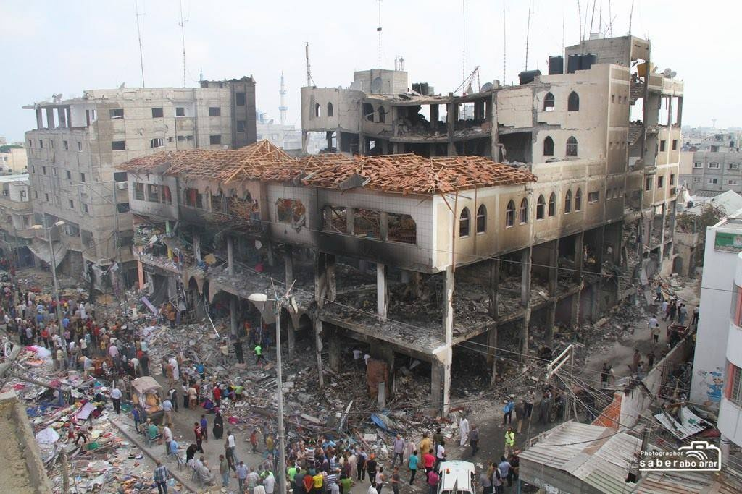
More Destruction

Slide 5
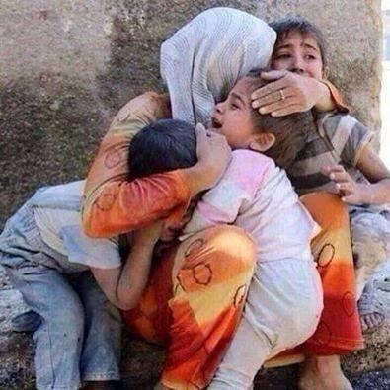
A mother trying to protect her children

Slide 6
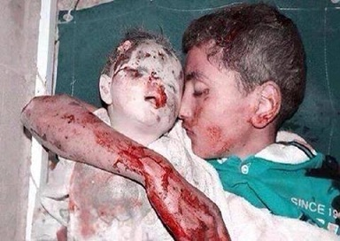
A Child Tried to Protect his Baby Brother...

Slide 7
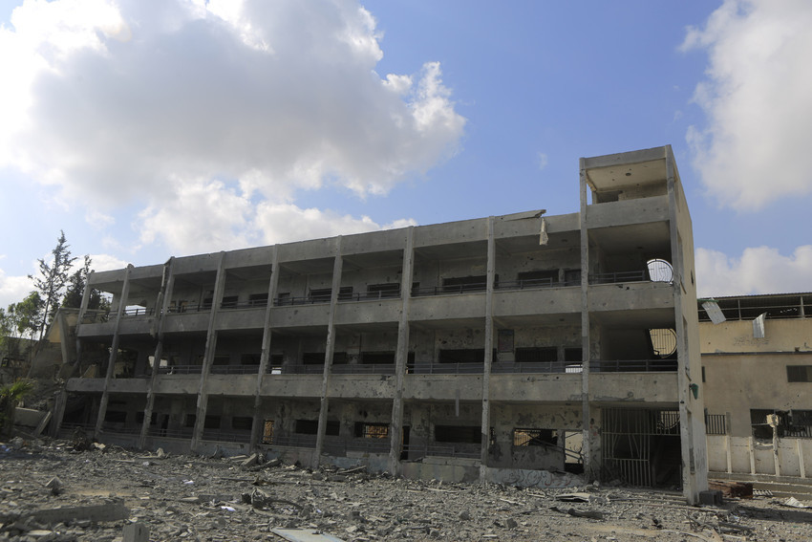
Jamal Abed el Nasser school in Shujaiyya destroyed
The only school in that area!

Slide 8
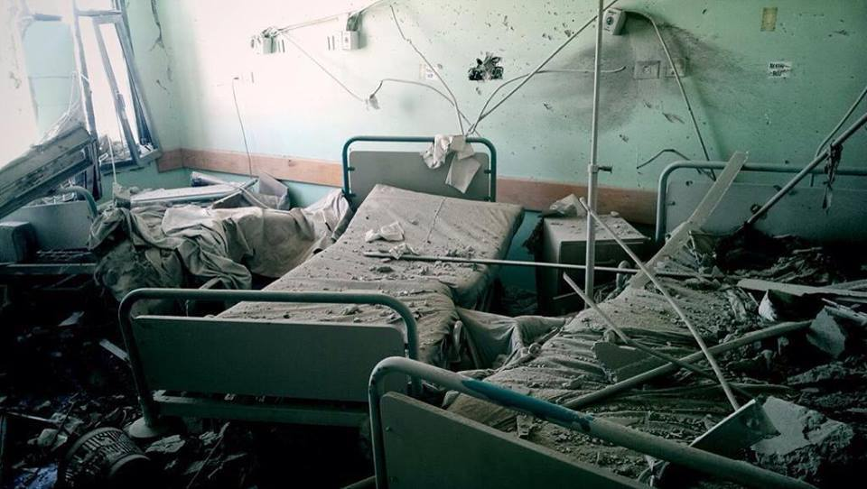
Israel shells Al Aqsa Martyrs Hospital

Slide 9
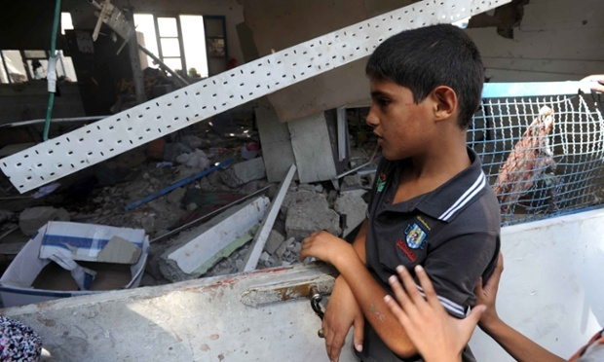
UN-run schools acting as civilian shelters have been hit seven times during Israel’s Gaza offensive

Slide 10
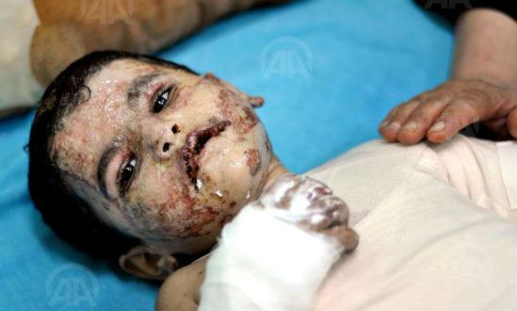
Euro-mediterranean Monitor In Gaza 1000 child will suffer from permanent disability

Slide 11
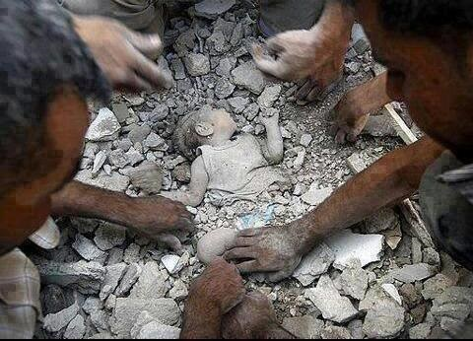
A Baby Saved from the rubbles

Slide 12
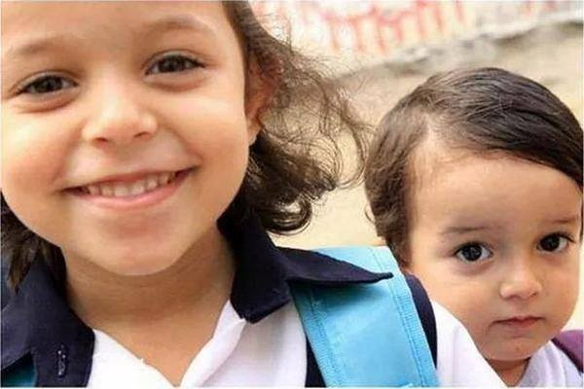
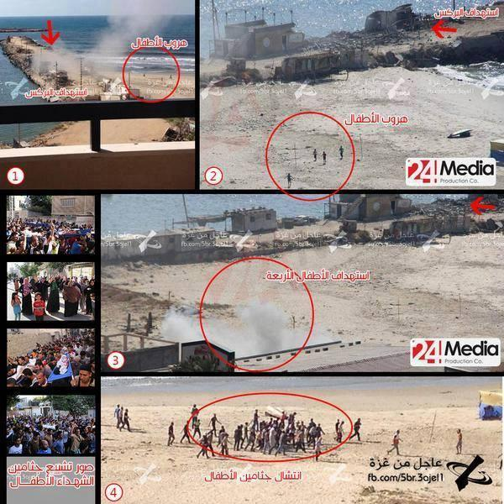
This girl and her brother were killed by Israeli aggression
4 children killed while playing on the beach of Gaza.

Slide 13
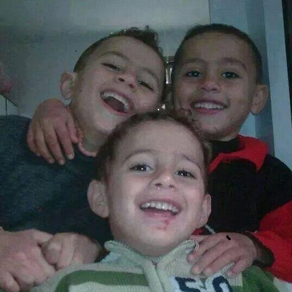
The three brothers were killed with their mother in an airstrike

Slide 14
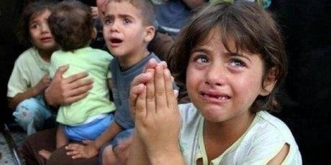
Horrified children

Slide 15
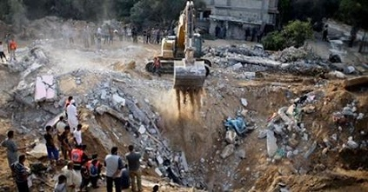
25 members of a single family killed when their houses were bombed to rubbles!

Slide 16
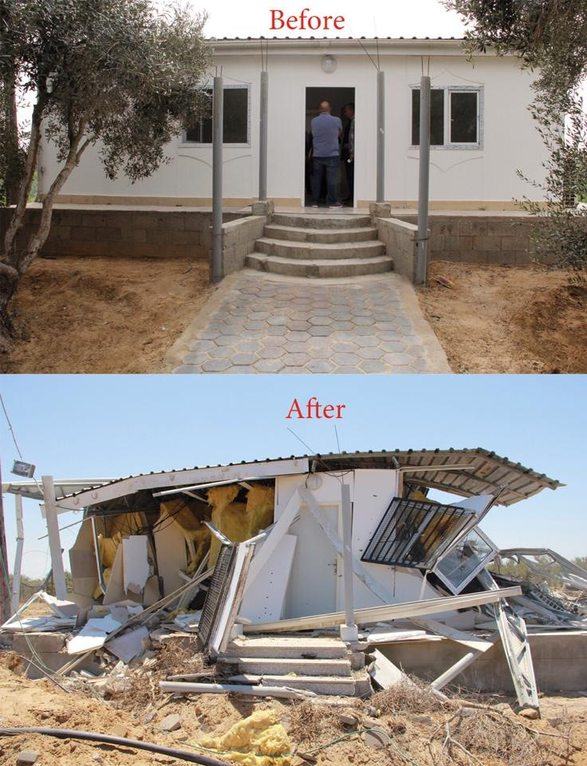
MA’AN Centre in Gaza before and after!

Slide 17
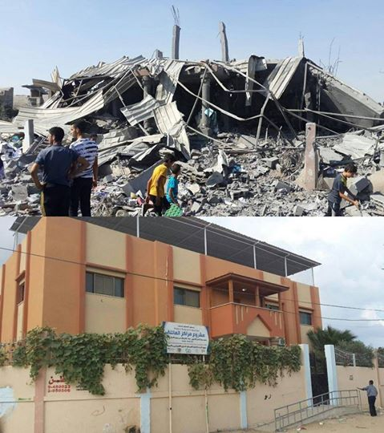
IBBY library Al-Ataa in Beit Hanoun before and after!

Slide 18
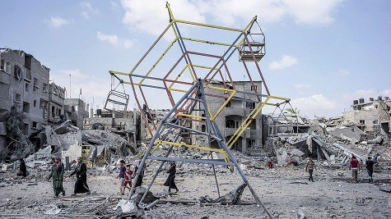
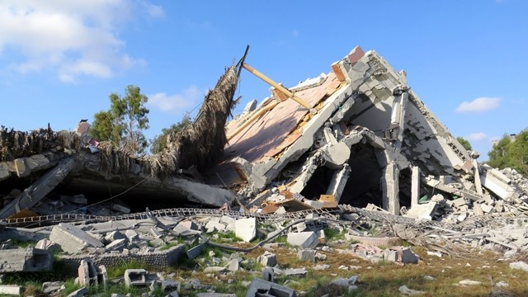
Gaza-children Facilities destroyed
Children Park
Gaza Zoo

Slide 19
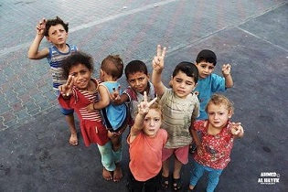
Children Never Loose Hope

Slide 20
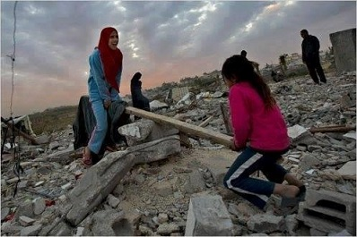
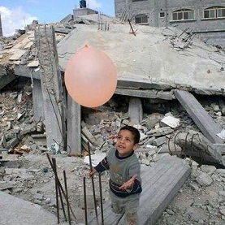
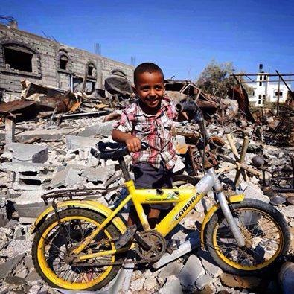
I am a child who wants to play Please give me a chance!

Slide 21
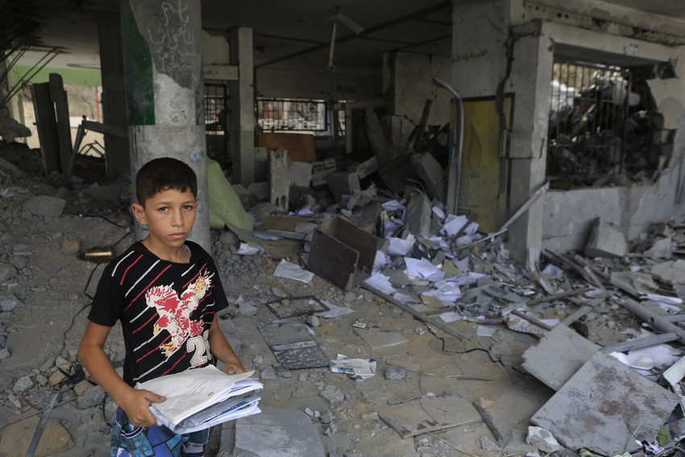
Gaza Children are Meant to Go Back to School

Slide 22
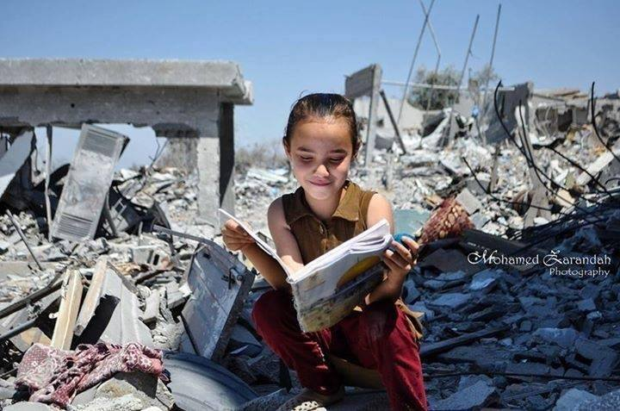
A Palestinian girl reading on top of all the destruction !

Slide 23
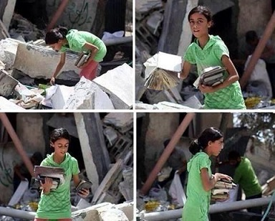
Looking for books among Destruction
The Love of Books!

Slide 24
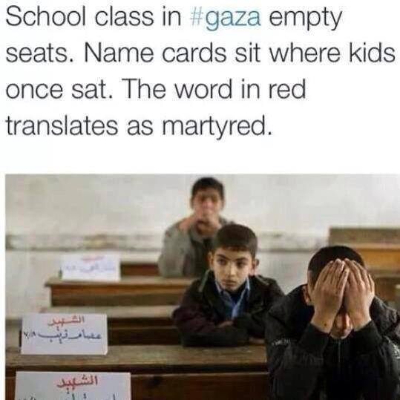

Slide 25
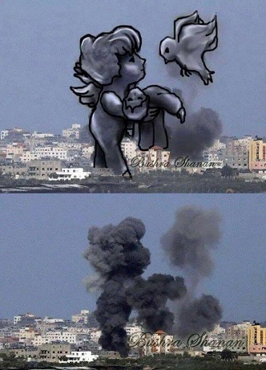
War and Art

Slide 26
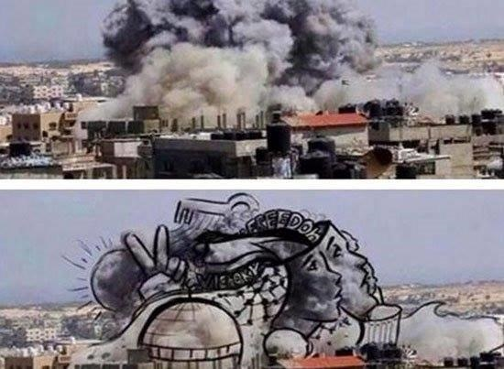

Slide 27
IBBY will always support the Convention on the Rights of the Child in Gaza and around the world.
IBBY libraries will be restored and brought back to life, we will never lose faith in the Power of Books !

Slide 28
